Slide 1


CM3070 Final Project Proposal
Topic: CM3030 Games Development
Project Idea Title 2: PC ‘mouse only’/Mobile game
Guo MingLin - 210220094

Slide 2
Problem and Background
Tower Defence (TD) is a subgenre of strategy games focused on protecting your territories from enemy attacks or preventing them from reaching exit points. Players achieve this by strategically placing defensive structures along the enemy's path, which then automatically obstruct, attack, or eliminate the oncoming threats. TD games are categorized within real-time strategy (RTS) games, although some modern TD games integrate turn-based elements. The essence of TD gameplay still revolves around making tactical decisions to effectively position defensive structures.
Worldwide, more than 170 million people play tower defence games, with an average lifetime spend of $8. (Rees, 2022) Therefore TD have huge player base and market share.
A common issue in TD games is the repetitive gameplay, with levels often having the same enemies and difficulties (Sutoyo et al., 2015). To overcome this, the new playstyle aims to provide a fresh and engaging experience, avoiding the boredom of repetition.

Slide 3
Motivation
The current Tower Defence (TD) games are lack of innovation and repetitive. By creating an innovative mouse only TD game, that is different from the traditional TD game. Users will be able to pick up the game easily. As the current games in the market are about the same play style. By designing a new TD game with new mechanism, it can bring existing TD players new gaming experience. As repetitive gaming will deter users from playing the game. The mouse only format allows for smoother cross platform compatibility, as mouse controls on a PC can mimic touch gestures on mobile devices.

Slide 4

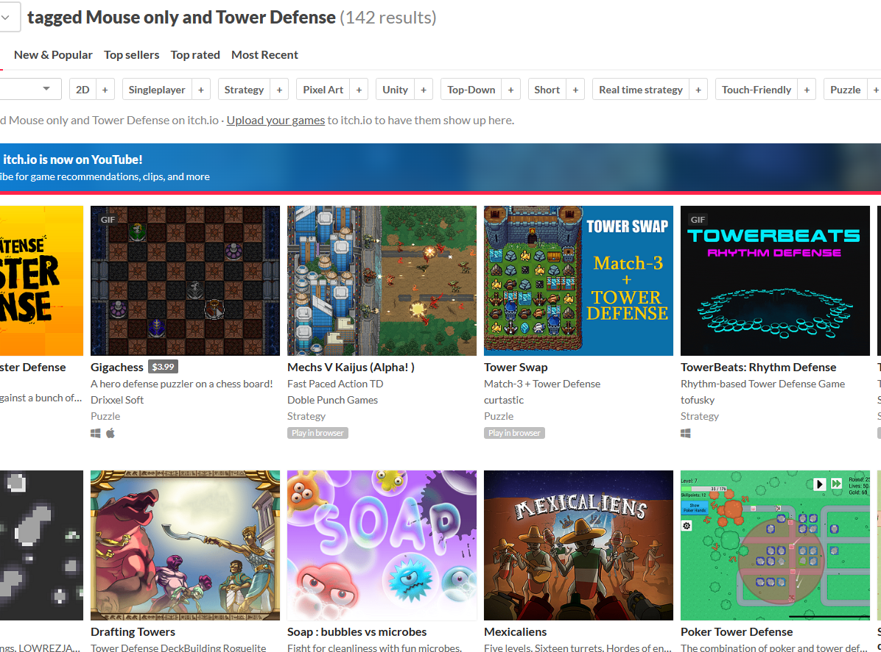
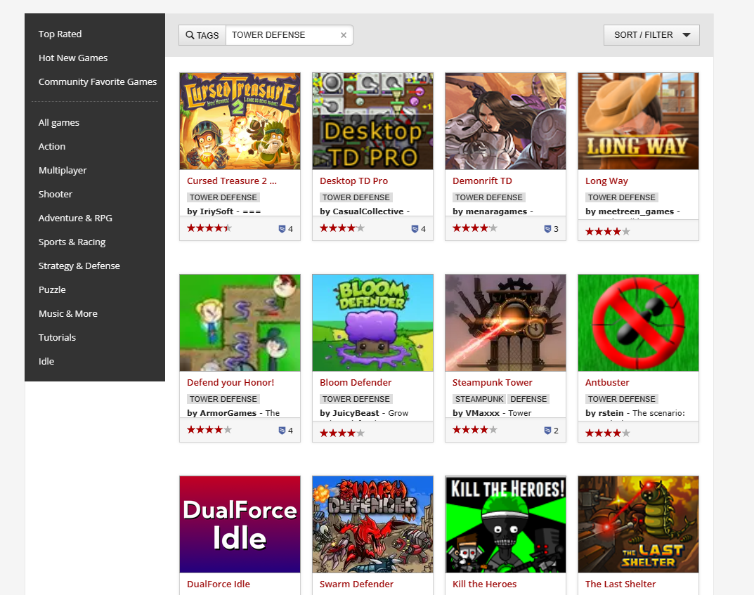
Background Research on Existing mouse only Tower Defense Games
Some features of TD in the market
Player-placed obstructions that can damage or kill enemy before they destroy the base
Ability to repair & upgrade
Enemies capable of traversing multiple paths
Each wave usually has a set number and types of enemies

Slide 5
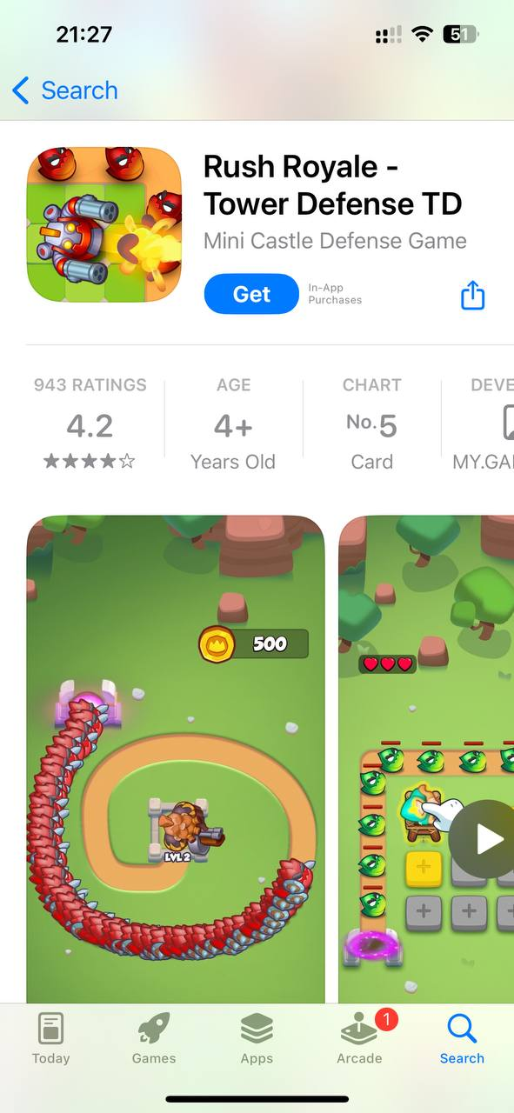
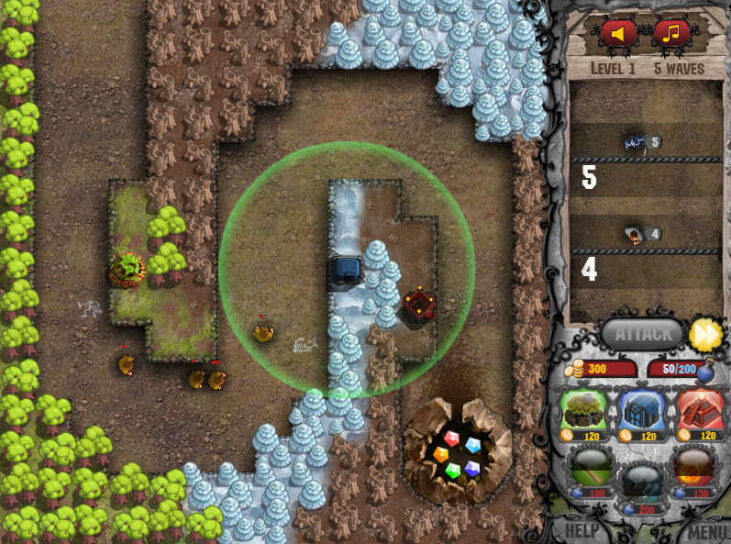
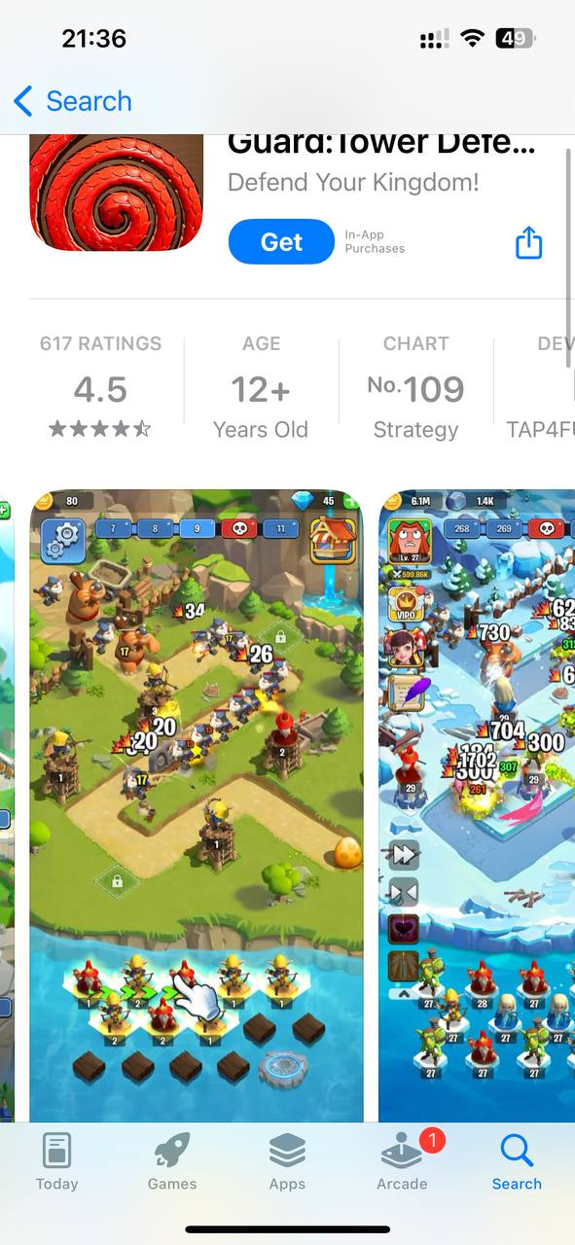
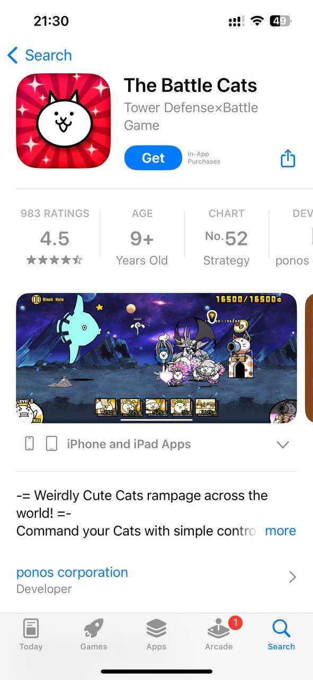
Existing Tower Defense Games
Rush Royale (Mobile) (2D)
Guard: Tower Defence (Mobile) (3D)
Plants VS Zombies (PC/Mobile) (Side view)
The Battle Cats (Mobile) (Side view)
Cursed Treasure (PC) (Top Down)

Slide 6
Game Idea
Genre: Tower Defense Style
View: TopDown/2D
Single turret(change of weapon types or ammunition) (NEW!)
Manual control of turret(Aim and fire) (NEW!)
Reaction mechanisms(elemental reactions) (NEW!)
Levelling up of weapons(XP/Gold)
No fixed enemy spawn pattern(Gamemode) (NEW!)
Points system(compelling and replayable)

Slide 7
References
Browse mouse only games. Mouse Only games on Kongregate. (n.d.). https://www.kongregate.com/mouse-only-games?sort=gameplays&tag=Tower%2BDefense
Top games tagged mouse only and Tower Defense. itch.io. (n.d.). https://itch.io/games/tag-mouse-only/tag-tower-defense
Sutoyo, R., Winata, D., Oliviani, K., & Supriyadi, D. M. (2015). Dynamic difficulty adjustment in tower defence. Procedia Computer Science, 59, 435–444. https://doi.org/10.1016/j.procs.2015.07.563
Wikimedia Foundation. (2023, October 6). Tower defense. Wikipedia. https://en.wikipedia.org/wiki/Tower_defense
Rees, L. (2022, September 14). Tower Defence Games to reach $2.3 billion in revenue by 2030. pocketgamer.biz. https://www.pocketgamer.biz/news/79629/tower-defence-games-to-reach-23-billion-in-revenue-by-2030/
App Store(APPLE)

